Slide 1
Collection Mapping

Slide 2
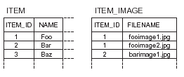

Slide 3
hbm
<set name="images" lazy="true" table="ITEM_IMAGE">
<key column="ITEM_ID"/>
<element type="string" column="FILENAME" not-null="true"/>
</set>
The <key> element declares the foreign key, ITEM_ID of the parent entity.
The <element> tag declares this collection as a collection of value type instances: in this case, of strings.
A set can’t contain duplicate elements, so the primary key of the ITEM_IMAGE table consists of both columns in the <set> declaration: ITEM_ID and FILENAME.

Slide 4
bag
An unordered collection that permits duplicate elements is called a bag.
An <idbag> mapping lets us attach a surrogate key column to the collection table.
<idbag name="images" lazy="true" table="ITEM_IMAGE">
<collection-id type="long" column="ITEM_IMAGE_ID">
<generator class="sequence"/>
</collection-id>
<key column="ITEM_ID"/>
<element type="string" column="FILENAME" not-null="true"/>
</idbag>

Slide 5
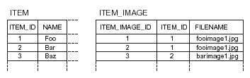

Slide 6
list
Ordered Collection
A <list> mapping requires the addition of an index column to the database table.
The index column defines the position of the element in the collection.
<list name="images" lazy="true" table="ITEM_IMAGE">
<key column="ITEM_ID"/>
<index column="POSITION"/>
<element type="string" column="FILENAME" not-null="true"/>
</list>
The primary key consists of the ITEM_ID and POSITION columns.

Slide 7


Slide 8
Map
Mapping a <map> is similar to mapping a list
<map name="images" lazy="true" table="ITEM_IMAGE">
<key column="ITEM_ID"/>
<index column="IMAGE_NAME" type="string"/>
<element type="string" column="FILENAME" not-null="true"/>
</map>
The primary key consists of the ITEM_ID and IMAGE_NAME columns.
The IMAGE_NAME column stores the keys of the map.

Slide 9
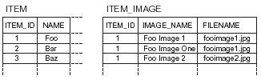

Slide 10
Sorted and ordered collection
<map name="images“ lazy="true"
table="ITEM_IMAGE"
  sort="natural">
<key column="ITEM_ID"/>
<index column="IMAGE_NAME" type="string"/>
<element type="string" column="FILENAME" not-null="true"/>
</map>

Slide 11
Comparator
<map name="images"
lazy="true"
table="ITEM_IMAGE"
sort="auction.util.comparator.ReverseStringComparator">
<key column="ITEM_ID"/>
<index column="IMAGE_NAME" type="string"/>
<element type="string" column="FILENAME" not-null="true"/>
</map>

Slide 12
Order-by
<map name="images“ lazy="true"
table="ITEM_IMAGE"
order-by="lower(FILENAME) asc">
<key column="ITEM_ID"/>
<index column="IMAGE_NAME" type="string"/>
<element type="string" column="FILENAME" not-null="true"/>
</map>

Slide 13
Collection of components
<set name="images“ lazy="true"
    table="ITEM_IMAGE"
order-by="IMAGE_NAME asc">
<key column="ITEM_ID"/>
<composite-element class="Image">
<property name="name" column="IMAGE_NAME" not-null="true"/>
<property name="filename" column="FILENAME" not-null="true"/>
<property name="sizeX" column="SIZEX" not-null="true"/>
<property name="sizeY" column="SIZEY" not-null="true"/>
</composite-element>
</set>

Slide 14
Inheritance mapping

Slide 15
Table per class hierarchy
The Entire class Hierarchy is mapped to a single table
This table would include columns for all properties of all classes in the hierarchy.

Slide 16
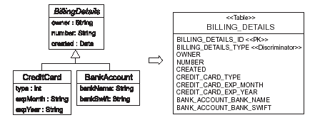

Slide 17
<hibernate-mapping>
<class name="BillingDetails“ table="BILLING_DETAILS" discriminator-value="BD">
<id name="id“ column="BILLING_DETAILS_ID“ type="long">
    <generator class="native"/>
    </id>
<discriminator column="BILLING_DETAILS_TYPE“ type="string"/>
  <property name="name“ column="OWNER“ type="string"/>
<subclass name="CreditCard“ discriminator-value="CC">
<property name="type“ column="CREDIT_CARD_TYPE"/>
...
</subclass>
...
</class>
</hibernate-mapping>

Slide 18
Have to use a special column to distinguish between persistent classes: the discriminator.
This isn’t a property of the persistent class; it’s used internally by Hibernate.
The column name is BILLING_DETAILS_TYPE, and the values will be strings in this case, "CC" or "BA".
Hibernate will automatically set and retrieve the discriminator values.

Slide 19
Table per subclass
Every subclass will declare persistent properties
The table here contains columns only for each non-inherited property along with a primary key that is also a foreign key of the superclass table.

Slide 20
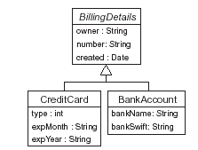
Object Model

Slide 21
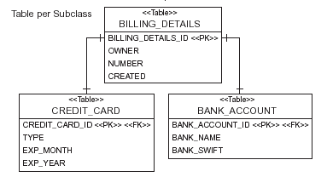
Relational Model

Slide 22
<?xml version="1.0"?><hibernate-mapping>
<class name="BillingDetails“ table="BILLING_DETAILS">
  <id name="id“ column="BILLING_DETAILS_ID“ type="long">
    <generator class="native"/>
</id>
<property name="owner“ column="OWNER“ type="string"/>
<joined-subclass name="CreditCard“ table="CREDIT_CARD">
<key column="CREDIT_CARD_ID">
<property name="type“ column="TYPE"/>
...
    </joined-subclass>
...
</class>
</hibernate-mapping>

Slide 23
Locking and Caching

Slide 24
Pessimistic Locking
A pessimistic lock is a lock that is acquired when an item of data is read and that is held
until transaction completion.

Slide 25
Lock modes in Hibernate
LockMode.NONE—Don’t go to the database unless the object isn’t in either cache.
LockMode.READ—Bypass both levels of the cache, and perform a version check to verify that the object in memory is the same version that currently exists in the database.
LockMode.UPDGRADE—Bypass both levels of the cache, do a version check
(if applicable), and obtain a database-level pessimistic upgrade lock, if that is supported.
LockMode.UPDGRADE_NOWAIT—The same as UPGRADE, but use a SELECT…FOR UPDATE NOWAIT on Oracle. This disables waiting for concurrent lock releases, thus throwing a locking exception immediately if the lock can’t be obtained.
LockMode.WRITE—Is obtained automatically when Hibernate has written to a row in the current transaction (this is an internal mode; you can’t specify it explicitly).
session.lock(item, LockMode.READ);

Slide 26
Version
<class name="Comment“ table="COMMENTS">
<id ...
<version name="version“ column="VERSION"/>
...
</class>
The version number is just a counter value
we don’t need to set the value of the version or timestamp property.
Hibernate will initialize the value when we first save a Comment, and increment or reset it whenever the object is modified.

Slide 27
Caching strategies and scopes
Transaction scope—Attached to the current unit of work, which may be an actual database transaction or an application transaction. It’s valid and used as long as the unit of work runs. Every unit of work has its own cache.
Process scope—Shared among many (possibly concurrent) units of work or transactions. This means that data in the process scope cache is accessed by concurrently running transactions, obviously with implications on transaction isolation.
Cluster scope—Shared among multiple processes on the same machine or among multiple machines in a cluster.

Slide 28
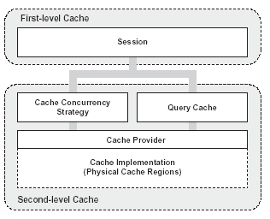

Slide 29
concurrency strategies
transactional—Available in a managed environment only. It guarantees full transactional isolation up to repeatable read.
read-write—Maintains read committed isolation, using a timestamping mechanism. It’s available only in non-clustered environments.
nonstrict-read-write—Makes no guarantee of consistency between the cache and the database. If there is a possibility of concurrent access to the same entity, you should configure a sufficiently short expiry timeout. Otherwise, you may read stale data in the cache. Use this strategy if data rarely changes
read-only—A concurrency strategy suitable for data which never changes.

Slide 30
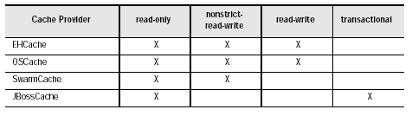
Cache providers

Slide 31
Cache declaration
<class name="Category“ table="CATEGORY">
<cache usage="read-write"/>
<id ....
</class>

Slide 32
hibernate.cache.provider_class=net.sf.ehcache.hibernate.Provider
EHCache has its own configuration file, ehcache.xml,should be in the application classpath

